Slide 1
Data Visualization Part 2

Slide 2
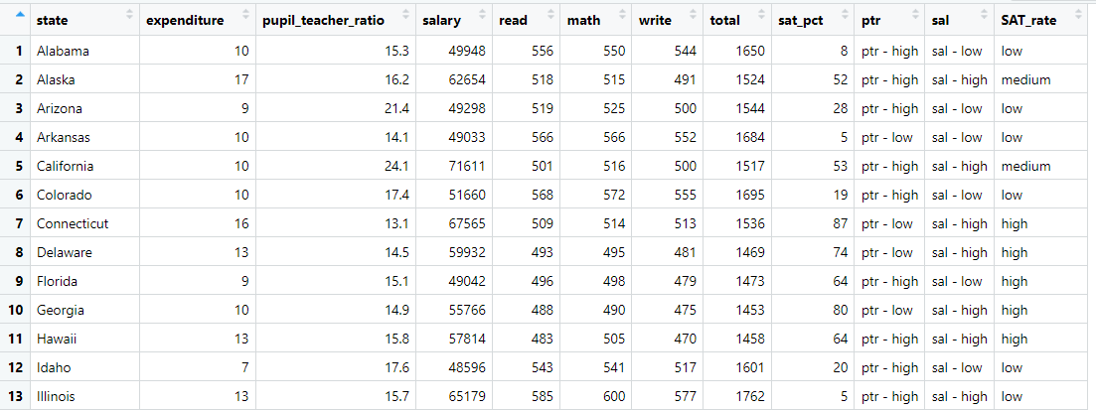
Data

Slide 3
We added three categorical variables to the dataset (SAT_2010):
SAT_2010 <- SAT_2010 %>%
mutate(ptr = ifelse(pupil_teacher_ratio >= 15, "ptr - high","ptr - low"),
sal = ifelse(salary >= 52000, "sal - high","sal - low"),
SAT_rate = cut(
sat_pct,
breaks = c(0, 30, 60, 100),
labels = c("low", "medium", "high")
))

Slide 4
Multivariate Displays
Bar Graphs

Slide 5
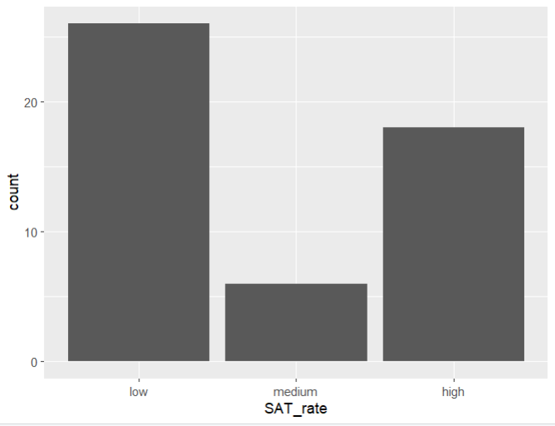
Figure 1: Make a bar graph with SAT_rate. Notice that this is a One Variable Bar Graph (it counts by default)
fig_1 <- SAT_2010 %>%
ggplot(aes(x = SAT_rate)) +
geom_bar()
fig_1

Slide 6
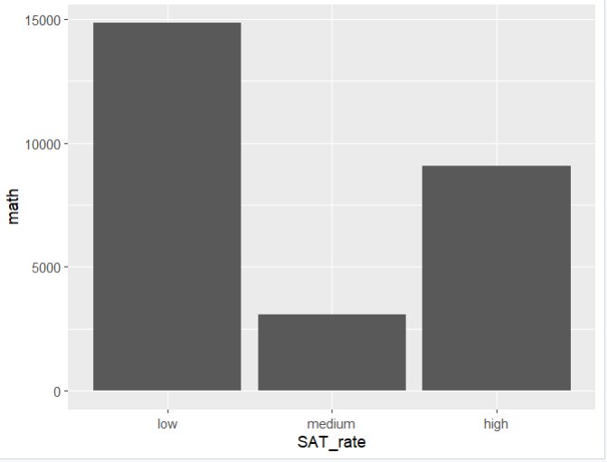
Figure 2: Make a bar graph with SAT_rate on the x axis and The Average Math Score on the y axis. Notice that this is a two Variable Bar Graph (you need stat = "identity")
fig_2 <- SAT_2010 %>%
ggplot(aes(x = SAT_rate,
y = math)) +
geom_bar(stat = "identity")
fig_2

Slide 7
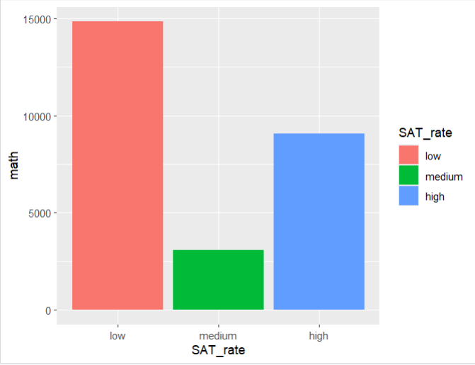
Figure 3: Make a bar graph with SAT_rate on the x axis and The Average Math Score on the y axis. Make every column a different color.
fig_3 <- SAT_2010 %>%
ggplot(aes(x = SAT_rate,
y = math,
fill = SAT_rate)) +
geom_bar(stat = "identity")
fig_3

Slide 8
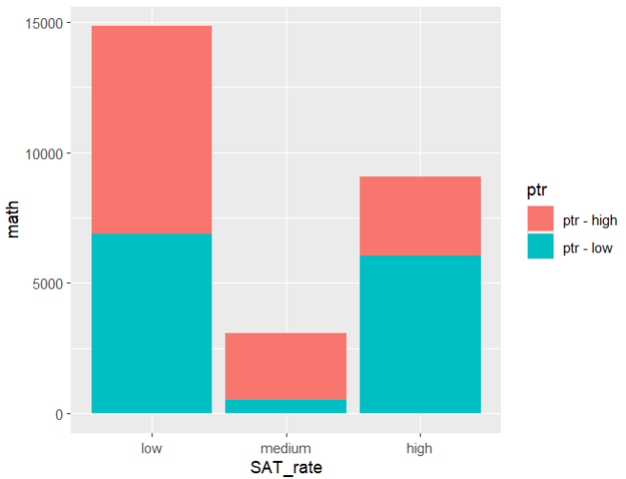
Figure 4: (Stacking by a third variable). Make a bar graph with SAT_rate on the x axis and The Average Math Score on the y axis. Stack the bars by the variable ptr.
fig_4 <- SAT_2010 %>%
ggplot(aes(x = SAT_rate,
y = math,
fill = ptr)) +
geom_bar(stat = "identity")
fig_4

Slide 9
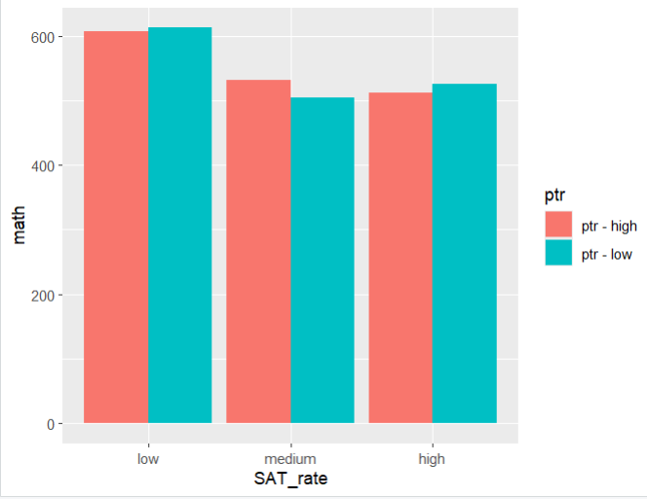
Figure 5: (Grouped Bar Graph). Make a bar graph with SAT_rate on the x axis and The Average Math Score on the y axis. Group the bars by the variable ptr.
fig_5 <- SAT_2010 %>%
ggplot(aes(x = SAT_rate,
y = math,
fill = ptr)) +
geom_bar(stat = "identity",
position = "dodge")
fig_5

Slide 10
Box Plots

Slide 11
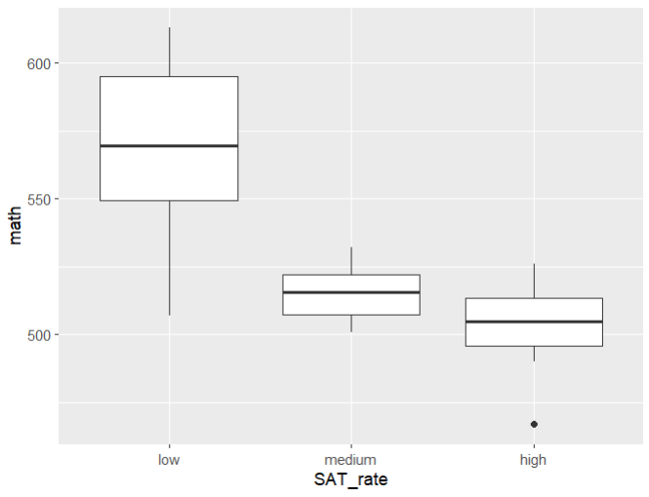
Figure 6: Make side by side box plots with SAT_rate on the x axis and The Average Math Score on the y axis.
fig_6 <- SAT_2010 %>%
ggplot(aes(x = SAT_rate,
y = math)) +
geom_boxplot()
fig_6

Slide 12
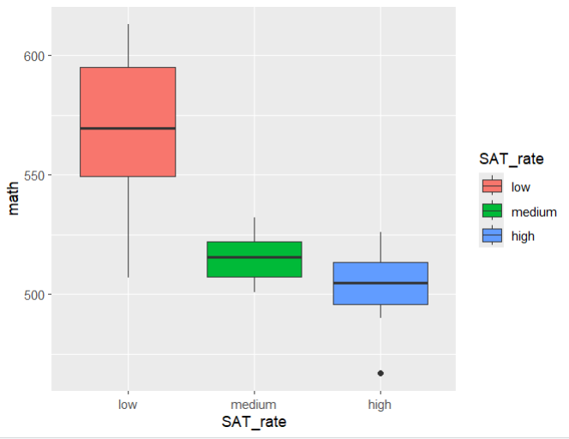
Figure 7: Make side by side box plots with SAT_rate on the x axis and The Average Math Score on the y axis. Change the filling color of each SAT_rate.
fig_7 <- SAT_2010 %>%
ggplot(aes(x = SAT_rate,
y = math,
fill = SAT_rate)) +
geom_boxplot()
fig_7

Slide 13
Scatter Plots

Slide 14
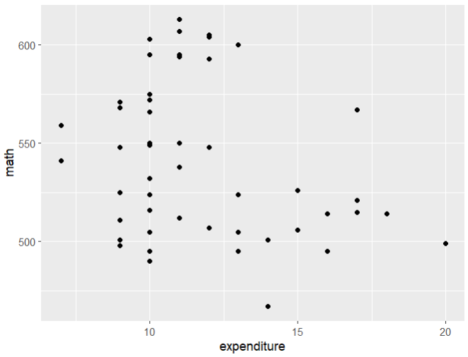
Figure 8: Create a Scatter Plot on the Expenditure and The Average Math SAT Score.
fig_8 <- SAT_2010 %>%
ggplot(aes(x = expenditure,
y = math)) +
geom_point()
fig_8

Slide 15
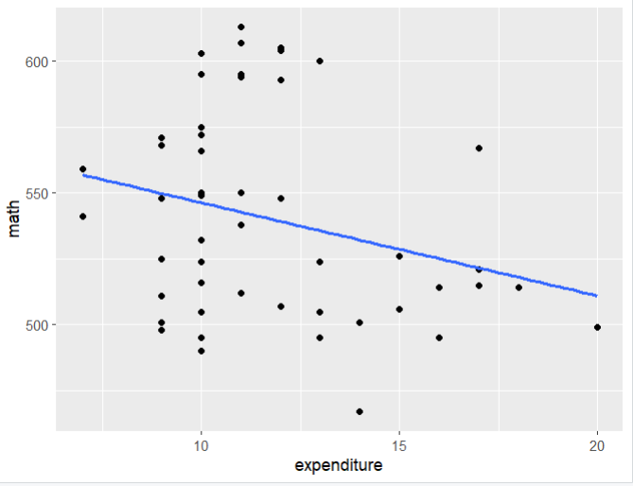
Figure 9: Create a Scatter Plot on the Expenditure and The Average Math SAT Score and add a trend line with ggplot.
fig_9 <- SAT_2010 %>%
ggplot(aes(x = expenditure,
y = math)) +
geom_point() +
geom_smooth(method = "lm",
se = FALSE)
fig_9

Slide 16
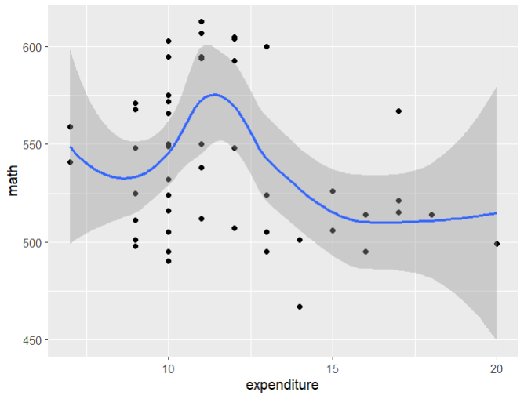
Figure 10: Create a Scatter Plot on the Expenditure and The Average Math SAT Score and add a polynomial fitting with the standard error band.
fig_10 <- SAT_2010 %>%
ggplot(aes(x = expenditure,
y = math)) +
geom_point() +
geom_smooth(method = "loess",
se = TRUE)
fig_10

Slide 17
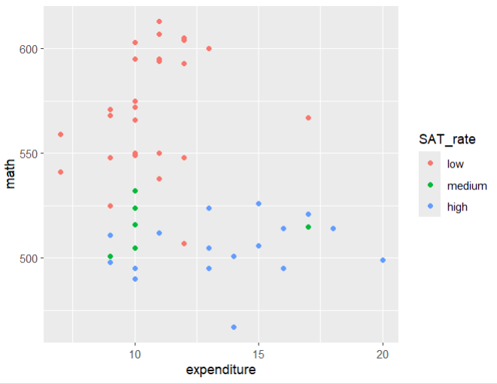
Figure 11: Create a Scatter Plot on the Expenditure and The Average Math SAT Score and split the data with different colors by SAT_rate.
fig_11 <- SAT_2010 %>%
ggplot(aes(x = expenditure,
y = math,
color = SAT_rate)) +
geom_point()
fig_11

Slide 18
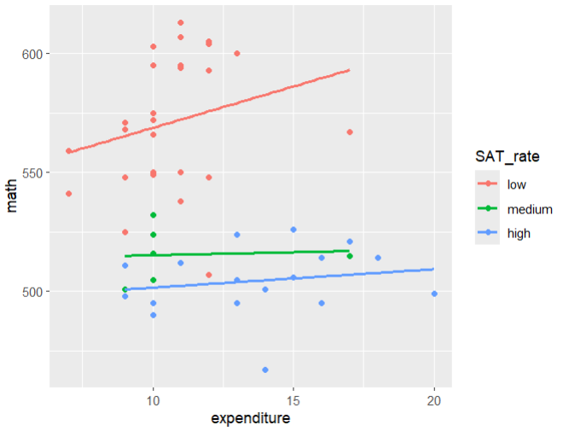
Figure 12: Create a Scatter Plot on the Expenditure and The Average Math SAT Score and split the data with different colors by SAT_rate. Add a trend line.
fig_12 <- SAT_2010 %>%
ggplot(aes(x = expenditure,
y = math,
color = SAT_rate)) +
geom_point() +
geom_smooth(method = "lm",
se = FALSE)
fig_12

Slide 19
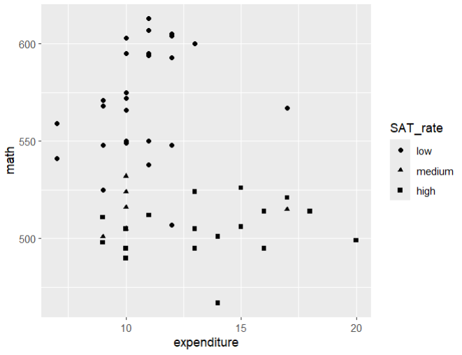
Figure 13: Create a Scatter Plot on the Expenditure and The Average Math SAT Score and split the data with different shapes by SAT_rate.
fig_13 <- SAT_2010 %>%
ggplot(aes(x = expenditure,
y = math,
shape = SAT_rate)) +
geom_point()
fig_13

Slide 20
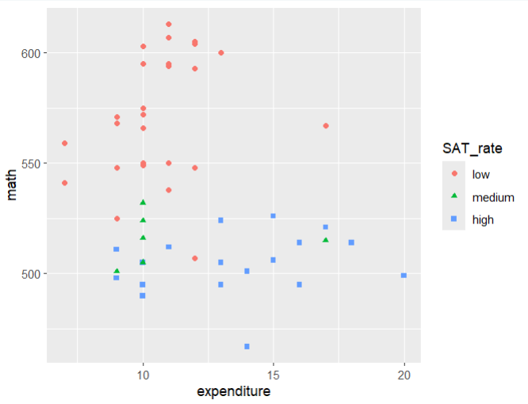
Figure 14: Create a Scatter Plot on the Expenditure and The Average Math SAT Score and split the data with different shapes and colors by SAT_rate.
fig_14 <- SAT_2010 %>%
ggplot(aes(x = expenditure,
y = math,
color = SAT_rate,
shape = SAT_rate)) +
geom_point()
fig_14

Slide 21
Faceting
This is similar to using shape or color for a categorical variables but puts them on separate plots.

Slide 22
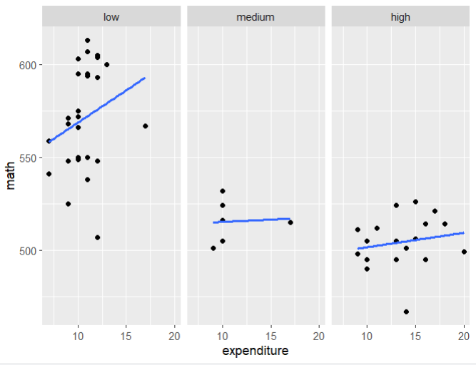
Facet with 1 variable
Figure 15: Create a Scatter Plot on the Expenditure and The Average Math SAT Score and split the data by SAT_rate where each category is a separate plot. Include a trend line.
fig_15 <- SAT_2010 %>%
ggplot(aes(x = expenditure,
y = math)) +
geom_point() +
geom_smooth(method = "lm",
se = FALSE) +
facet_wrap(~SAT_rate)
fig_15

Slide 23
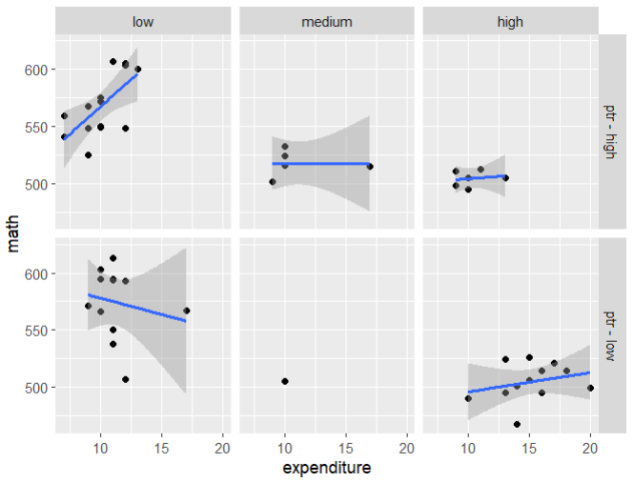
Facet with 2 variables
Figure 16: Create a Scatter Plot on the Expenditure and The Average Math SAT Score and split the data by SAT_rate and ptr where each pair of categories is a separate plot. Include a trend line with a standard error band.
fig_16 <- SAT_2010 %>%
ggplot(aes(x = expenditure,
y = math)) +
geom_point() +
geom_smooth(method = "lm",
se = TRUE) +
facet_grid(ptr ~ SAT_rate)
fig_16

Slide 24
Do it Yourself – Recreate These Plots

Slide 25
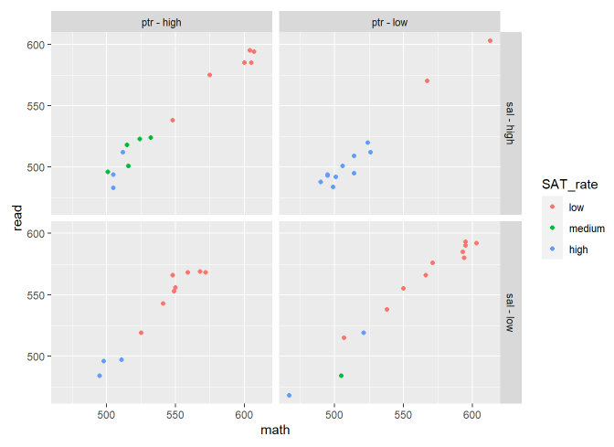
Plot # 1

Slide 26
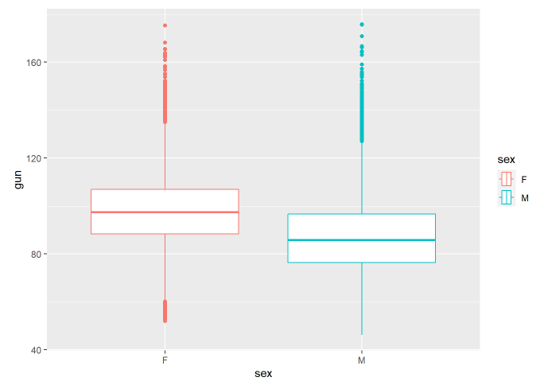
Plot # 2

Slide 27
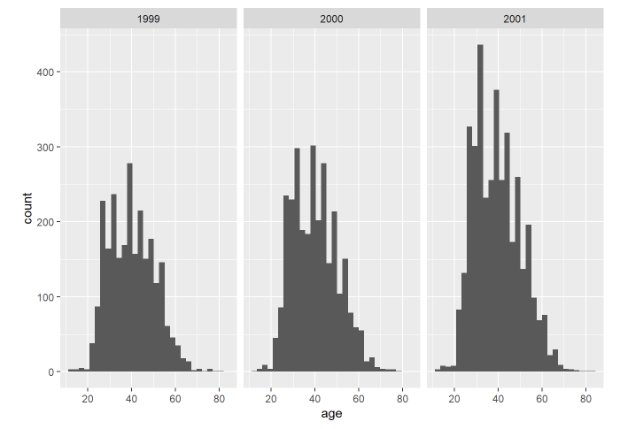
Plot # 3

Slide 28
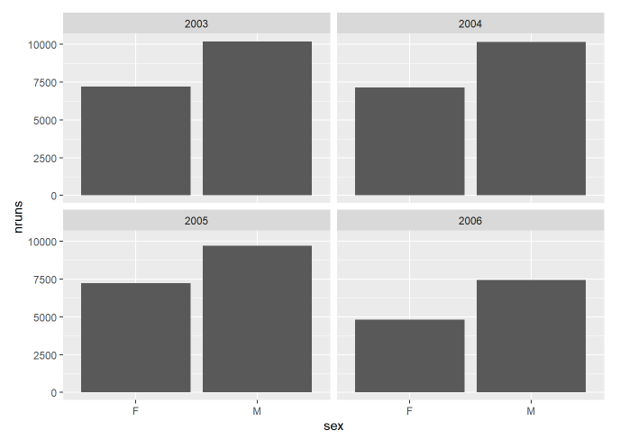
Plot # 4

Slide 29
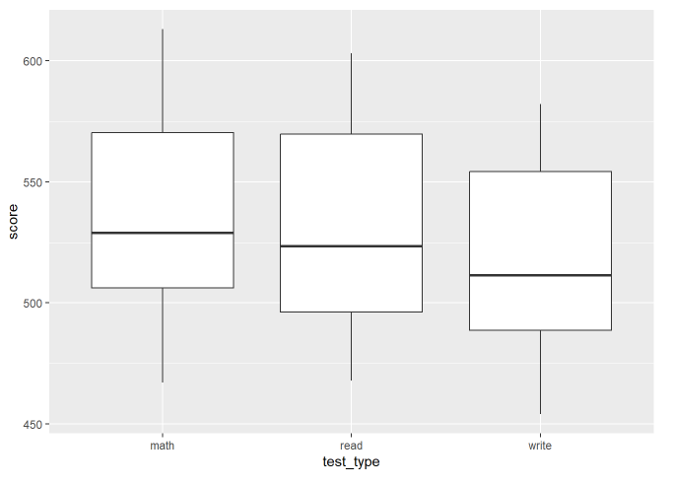
Plot # 5

Slide 30
Plot # 1
Plot # 2
Plot # 3
Plot # 4
Plot # 5

